Slide 1
Influences on Achievement
Learning what affects student learning the most

Slide 2
Objectives
Review the work on student achievement by educational researcher John Hattie
Identify and surface the challenges of the research and personal biases
Understand the top 10 greatest leverage points that exponentially impact student achievement
Identify and research one influence area that you want to learn more about

Slide 3
Who is John Hattie?
Current Director of the Melbourne Educational Research Institute at the University of Melbourne, Australia
Former Professor of Education and Director of the Visible Learning Labs, University of Auckland, New Zealand
Author of Visible Learning, a synthesis of meta-analyses of student achievement
High school English teacher
Middle school teacher
Notes:
Ask the group what do you know about him and his work

Slide 4
What is Visible Learning & Teaching?
The Visible Learning research is based on a synthesis of 1,200 meta-analyses relating to influences on student achievement
Hattie assigned a value (effect size) to each of the many influences on student achievement and then ranked them
As nearly every intervention can show some evidence of success, we can best support students by shifting our focus and efforts from “What works” to “What works best” and seek comparisons between different ways of influencing student learning
Notes:
Diet analogy

Slide 5
Why Visible Learning?
There have been so many studies, programs, beliefs and findings--many of it contradictory
95% of everything “works”; you will see progress; but “What works best?”
What influences have the biggest impact on student achievement--beyond natural growth and progress?
2009, 2011, 2015

Slide 6
Critical Codicils
Only achievement was reviewed--not other effects of schooling like love of learning, belongingness, attitudes, etc.
Studies on innovations--not typical teaching--see slightly higher effects. That which you pay attention to gets results.
Averaging of studies--need to look deeper to see nuances
Caution: this is not meant to be a recipe for success--it is meant to inform and create culture of inquiry based on evidence, research, and efficacy

Slide 7
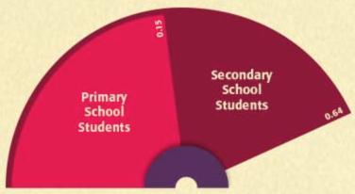
The Barometer of Influences
Each influence on student achievement has a corresponding effect size
Reverse effects have an effect size from -0.20-0.00
Developmental effects have an effect size from 0.00-0.20
Typical teacher effects have an effect size from 0.20-0.40
The Zone of desired effects are the influences that have an effect size from 0.40-1.00
The average effect size is 0.40, therefore when choosing a path to improve achievement, choose something with a higher effect size to maximize gains
Notes:
HW example: 0.15 for primary, 0.64 secondary, overall average 0.29- ranked 94th

Slide 8
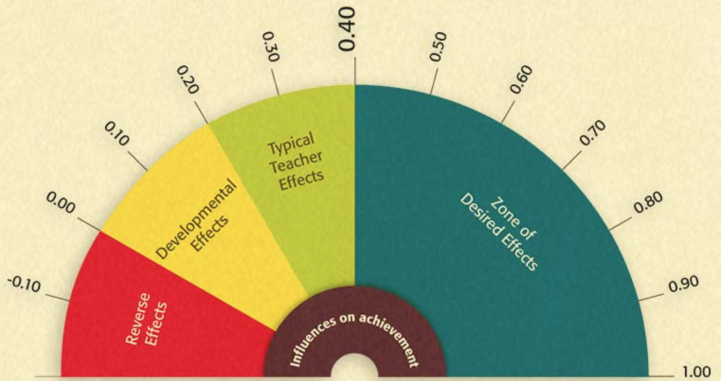
The Barometer of Influences
Notes:
Explain the barometer and why we need to maximize our time with students

Slide 9
Research Challenges & Personal Bias
Educators create solutions and then collect evidence to prove they are right
Some of the findings will surprise you and challenge your beliefs
Acknowledge your bias
Suspend your belief
Move away from judgement to inquiry
I may have seen growth, is it enough growth?
Is there another alternative that would accelerate growth and if so, why am I resistant?

Slide 10
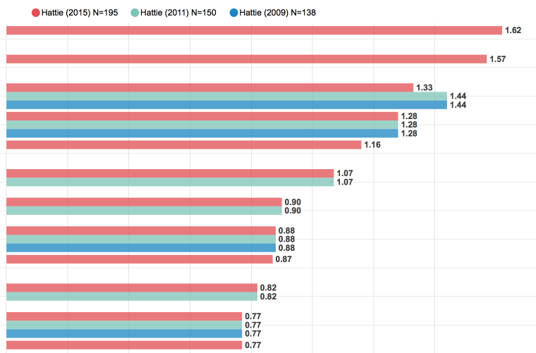
Hattie’s Ranking of Influences
Hattie Ranking Interactive Visualization
Notes:
Have participants follw the link and explore the full ranking list of influences. Have them toggle on and off the links to the three different studies (2009, 2011, 2015).

Slide 11
Activity
Influences On Achievement Activity (Session 1)
Influences On Achievement Activity (Session 2)
 | 2009 | 2011 | 2015
Rank | 138 influences studied | 150 influences studied | 195 influences studied
1 | Self-reported grades | Self-reported grades | Teacher estimates of achievement*
2 | Piagetian programs | Piagetian programs | Collective teacher efficacy*
3 | Providing formative evaluation | Response to intervention | Self-reported grades
4 | Micro teaching | Providing formative evaluation | Piagetian programs
5 | Acceleration | Teacher credibility | Conceptual change programs*
6 | Classroom behavioral | Micro teaching | Response to intervention
7 | Interventions for learning disabled | Classroom discussion* | Teacher credibility
8 | Teacher clarity | Interventions for learning disabled | Micro teaching
9 | Reciprocal teaching | Teacher clarity | Cognitive task analysis*
10 | (Descriptive) Feedback | Reciprocal teaching | Classroom discussion
Notes:
Split participants into groups and assign one (or two) of the 17 topics, click on the link to the shared Google doc, follow the links and/or read the hard copy definition/explanation of your assigned academic influence (and/or watch the brief linked video), discuss as a group, then complete the table in the shared Google doc for your assigned topics, and be prepared to share with the group.

Slide 12
Questions, Affirmations, & Ponderings
There is no recipe for success
Beliefs and conceptions held by teachers need to questioned--not wrong or right--but looking at efficacy
Caution: it is important to recognize and value the effective influences already present in our classrooms, while focusing on increasing the most effective practices

Slide 13
Personal Application
Identify and research one influence area that you want to learn more about
Review Hattie Ranking on Interactive Visualization and research one that interests you

Slide 14
Resources
Visible Learning Website
Articles:
What Works in Education - Hattie’s list of the greatest effects and why it matters
8 Strategies Robert Marzano and John Hattie Agree On

